Slide 1


Team: Visionary Providers
Shrestha Datta
Md Adith Mollah
Department of CSE, SUST
Department of CSE, SUST

Slide 2
Project Idea Summary
Agricultural domain contributes significantly to our country in
terms of economic enhancement. Farmers play a big role in this
particular phase. Due to the lack of modern domain knowledge of
the farmers about their respective crops' fruitful development,
every year countless amounts of crops are getting wasted and
destroyed which could have played a massive role in generating
huge revenue for our country.
That’s why we propose a Java web based application integrated
with Artificial Intelligence (AI) named “AgriDoctor”, aiming to
solve the problems described above, providing a user friendly
environment, automating tasks, saving a bunch of time,
educating farmers in a completely convenient manner, and
generating healthy revenue.

Slide 3
Project Demonstration

Slide 4
Key Features
3 core services : Crop Recommendation, Fertilizer Recommendation, Plant Disease Prediction
Multilingual Service (Bengali and English)
User Feedback to Admin, query transaction (1tk per query), prototype payment gateway
JWT Authentication, Email verification through token, Authorization, Role Based Access (Admin, Normal User).

Slide 5
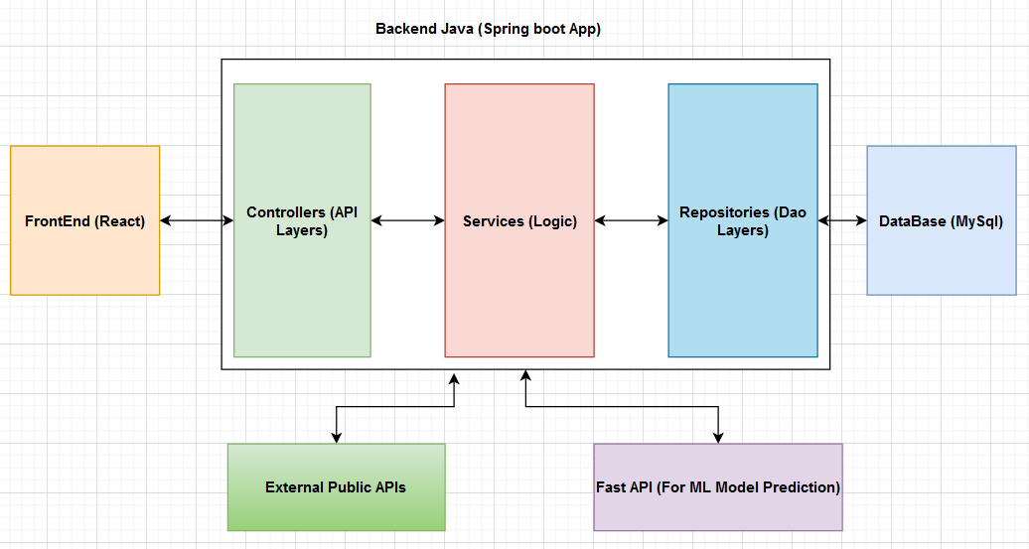
Project Architecture
Fig. 1: Project Architecture

Slide 6
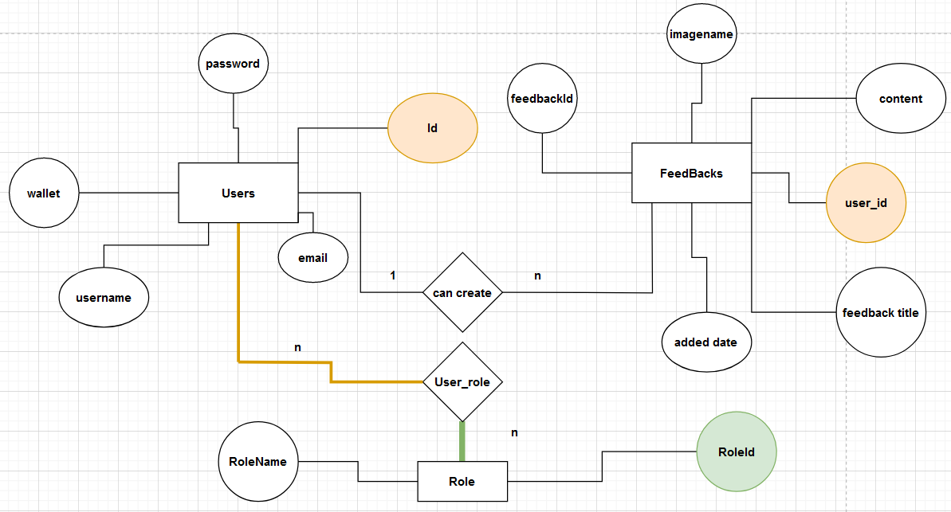
Database Schema
Fig. 2: Database Schema

Slide 7
Used Technologies
Build tool : Maven
FrameWork: Spring boot (Java backend framework)
Libraries: Spring data JPA, JDBC, Spring Security, JavaMail, lombok, JSON web token
Database: MySQL

Slide 8
Used Technologies: Frontend
Build tool : create-react-app
Framework: React
Template Engine: JSX
Styling: CSS
Prebuilt Design Framework: react-bootstrap
HTTPs Request Library: Axios
Other libraries: react-toastify, react-router-dom
Image and Icon Credits: Flaticon, Freepik

Slide 9
Used Technologies: AI Backend
Build tool : Docker
Framework: Fast-API
ASGI Server: Uvicorn[standard]
Other Libraries: pydantic, python-multipart
AI libraries: pydantic, torch, tensorflow, scikit-learn, pillow

Slide 10
Future Works
Increasing the data diversity (for wheat and rice due to having black background in images)
Real time payment gateway.
Making general users aware and conveniently explain about contemporary research works applied in agricultural domain.
Providing more services for general users based on research works.

Slide 11
Thank you

